Slide 1

UNIVERSITY INSTITUTE OF ENGINEERING
COMPUTER SCIENCE ENGINEERING
Bachelor of Engineering (Computer Science & Engineering)
Subject Name: STATISTICAL METHODS USING R
Subject Code: 20SMT-460
Regression analysis
Mapped with CO
Prepared By:
Ms. Hardeep Kaur
DISCOVER . LEARN . EMPOWER

Slide 2
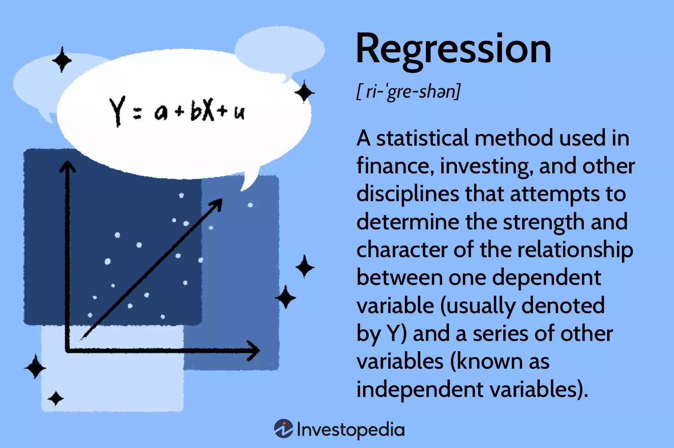

Slide 3
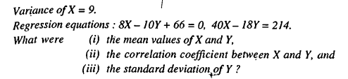
Examples

Slide 4
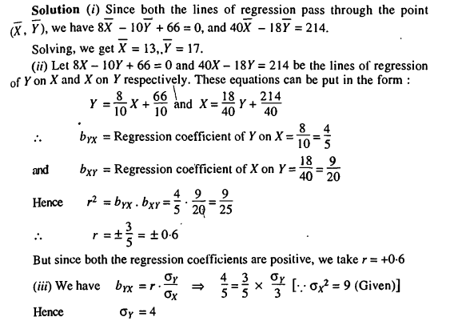

Slide 5
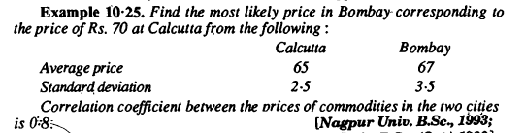

Slide 6
